Slide 1

K Nearest Neighbors

Slide 2
KNN
KNN (K nearest neighbors) is one of the simplest algorithms we will learn about!
Section Overview
KNN Theory and Intuition
KNN Classification Coding Example
KNN Exercise Overview
KNN Exercise Solution

Slide 3
KNN
While KNN can be used for regression tasks, its performance can be quite poor and less efficient than other algorithms, so we’ve decided not to exhibit its use for regression.
However if you do want to use it for regression it is very easy to swap in the KNNRegressor model with scikit-learn.

Slide 4
KNN
You may have also heard of K means algorithm.
K means is unrelated to KNN, be careful not to confuse the two due to their similar sounding names!

Slide 5
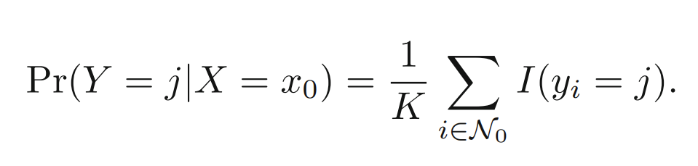
KNN
ISLR Relevant Reading
Chapter 2
Formula 2.12 starts discussion on KNN for classification.

Slide 6
KNN Classification
Theory and Intuition

Slide 7
KNN
K nearest neighbors is one of the simplest machine learning algorithms.
It simply assigns a label to new data based on the distance between the old data and new data.
Let’s go through the intuition with an example use case...

Slide 8
KNN
Sexing chicks is still a very manual process:
en.wikipedia.org/wiki/Chick_sexing
Let’s imagine we gathered a dataset of baby chick heights and weights.
How could we train an algorithm to identify the sex of a new baby chick based on historical features?

Slide 9
KNN
Imagine a height and weight data set
HEIGHT
WEIGHT

Slide 10
KNN
We historically know the sex of the chicks:
MALE
FEMALE
HEIGHT
WEIGHT

Slide 11
KNN
How would we assign sex to a new point?
MALE
FEMALE
HEIGHT
WEIGHT

Slide 12
KNN
We intuitively “know” this is likely female.
MALE
FEMALE
HEIGHT
WEIGHT

Slide 13
KNN
Intuition comes from distance to points!
MALE
FEMALE
HEIGHT
WEIGHT

Slide 14
KNN
What about a less obvious point?
MALE
FEMALE
HEIGHT
WEIGHT

Slide 15
KNN
How many points to we consider?
MALE
FEMALE
HEIGHT
WEIGHT

Slide 16
KNN
Let’s imagine a situation like this:
MALE
FEMALE
HEIGHT
WEIGHT

Slide 17
KNN
K=1
MALE
FEMALE
HEIGHT
WEIGHT

Slide 18
KNN
K=1
MALE
FEMALE
HEIGHT
WEIGHT

Slide 19
KNN
K=2
MALE
FEMALE
HEIGHT
WEIGHT

Slide 20
KNN
K=3
MALE
FEMALE
HEIGHT
WEIGHT

Slide 21
KNN
K=4 leads to a tie!
MALE
FEMALE
HEIGHT
WEIGHT

Slide 22
KNN
Tie considerations and options:
Always choose an odd K.
In case of tie,simply reduce K by 1 until tie is broken.
Randomly break tie.
Choose nearest class point.

Slide 23
KNN
What does Scikit-Learn do in case of tie?
Warning: Regarding the Nearest Neighbors algorithms, if it is found that two neighbors, neighbor k+1 and k, have identical distances but different labels, the results will depend on the ordering of the training data.

Slide 24
KNN
What does Scikit-Learn do in case of tie?
In the case of ties, the answer will be the class that happens to appear first in the set of neighbors.
Results are ordered by distance, so it chooses the class of the closest point.

Slide 25
KNN
K=4 leads to a tie!
MALE
FEMALE
HEIGHT
WEIGHT

Slide 26
KNN
Choose closest K
MALE
FEMALE
HEIGHT
WEIGHT

Slide 27
KNN
Choose closest K
MALE
FEMALE
HEIGHT
WEIGHT

Slide 28
KNN
K=5 causes a switch from previous K values.
MALE
FEMALE
HEIGHT
WEIGHT

Slide 29
KNN
How to choose best K value?
MALE
FEMALE
HEIGHT
WEIGHT

Slide 30
KNN
We want a K value that minimizes error:
Error = 1 - Accuracy
Two methods:
Elbow method.
Cross validate a grid search of multiple K values and choose K that results in lowest error or highest accuracy.

Slide 31
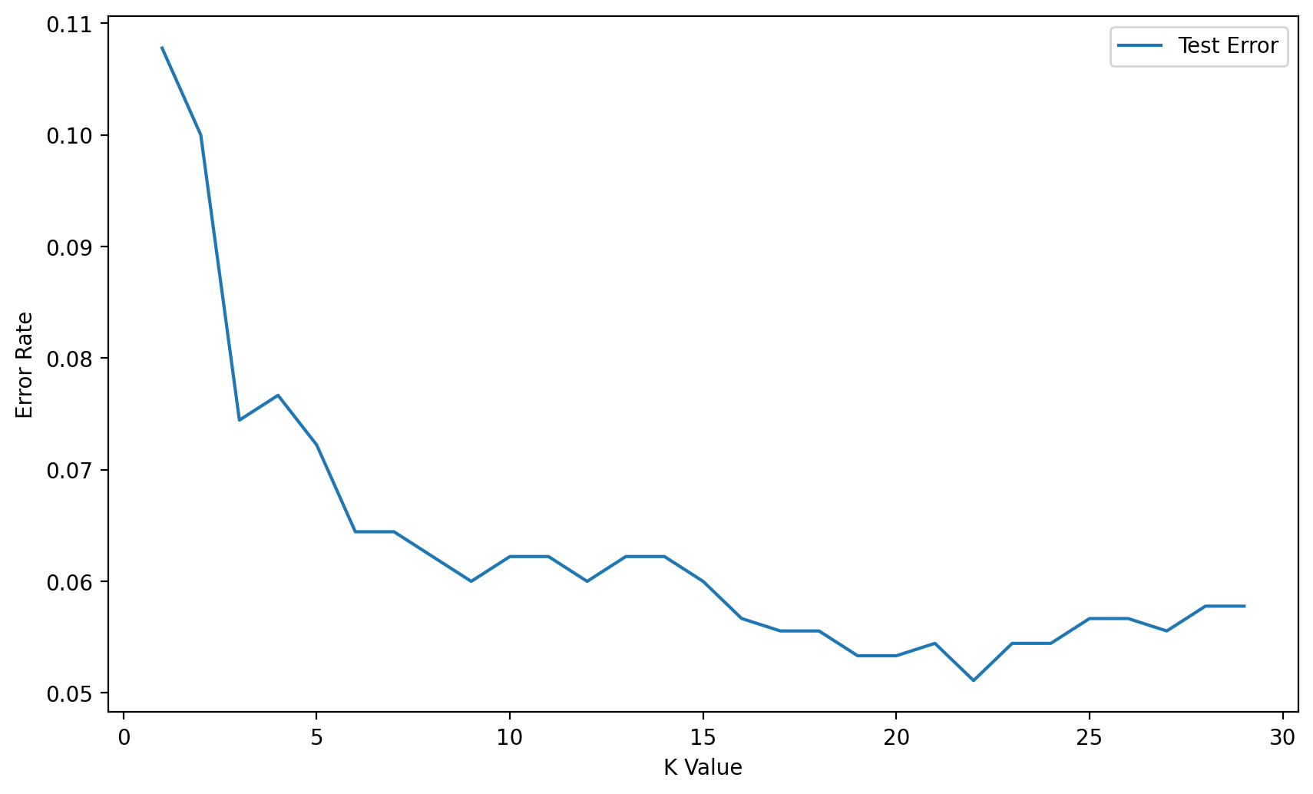
KNN
Elbow method:

Slide 32
KNN
Elbow method:

Slide 33
KNN
Elbow method:

Slide 34
KNN
Cross validation only takes into account the K value with the lowest error rate across multiple folds.
This could result in a more complex model (higher value of K).
Consider the context of the problem to decide if larger K values are an issue.

Slide 35
KNN
KNN Algorithm
Choose K value.
Sort feature vectors (N dimensional space) by distance metric.
Choose class based on K nearest feature vectors.

Slide 36
KNN
KNN Considerations:
Distance Metric
Many ways to measure distance:
Minkowski
Euclidean
Manhattan
Chebyshev

Slide 37
KNN
KNN Considerations:
Scaling for Distance
Features could have vastly different value ranges!
Feature 2
Feature 1

Slide 38
KNN
KNN Considerations:
Scaling for Distance
Features could have vastly different value ranges!
Feature 2
Feature 1

Slide 39
KNN
KNN Considerations:
Scaling for Distance
Features could have vastly different value ranges!
Feature 2
Feature 1

Slide 40
KNN
KNN Considerations:
Scaling is necessary for KNN.
Scaled Feature 2
Scaled Feature 1

Slide 41
KNN
While the KNN Algorithm is relatively simple, keep in mind the following considerations:
Choosing the optimal K value.
Scaling features.
Let’s continue to explore how to perform KNN for classification!

Slide 42
KNN Classification
Coding Part One: Data and Model

Slide 43
KNN Classification
Coding Part Two: Choosing K

Slide 44
KNN
A Pipeline object in Scikit-Learn can set up a sequence of repeated operations, such as a scaler and a model.
This way only the pipeline needs to be called, instead of having to repeatedly call a scaler and a model.

Slide 45
KNN Exercise
Overview

Slide 46
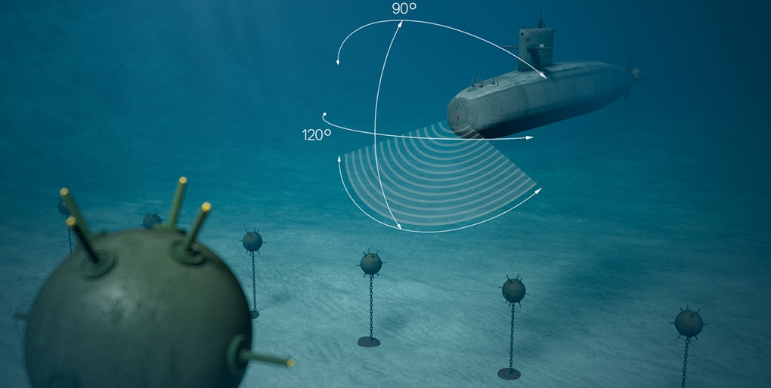
KNN
Let’s test your new skills on a real data set.
We’ll be analyzing sonar frequencies to help distinguish between rocks or sea mines!

Slide 47
KNN Exercise
Solutions

